Slide 1
Midterm Proposal
Chloe Young

Slide 2

Concept & Theme
Purpose: Personal portfolio website
Who I am?
My skills/experience
Showcase projects
Theme:
Bold colors
Lots of different types of fonts
Bright, fun, colorful

Slide 3


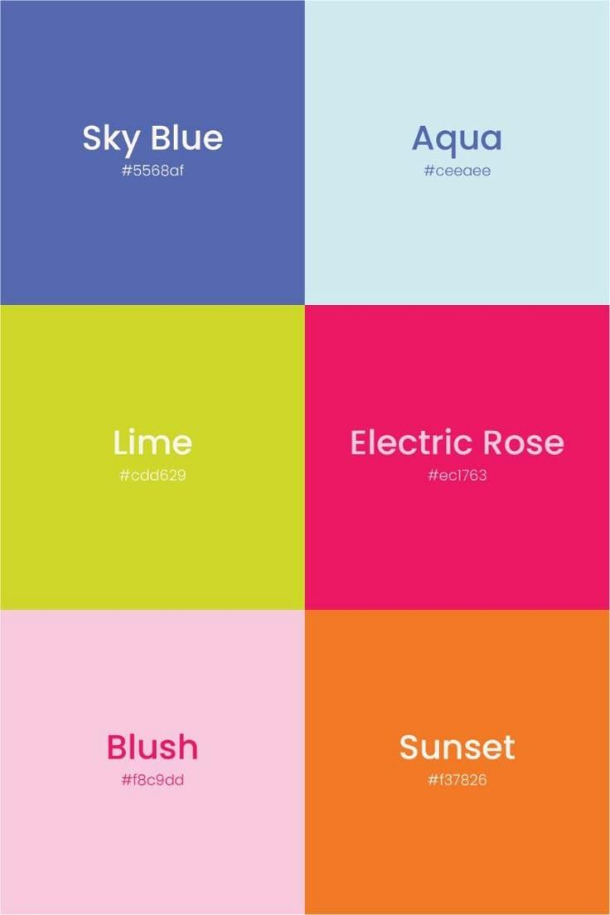
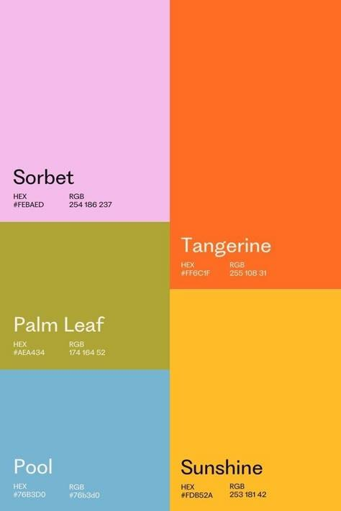
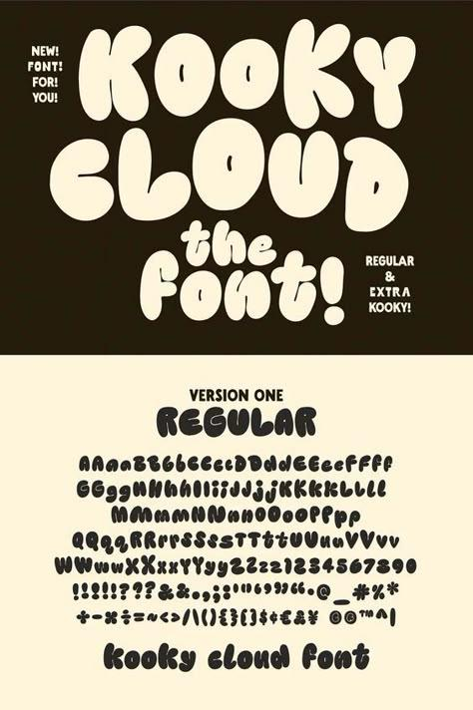


Slide 4

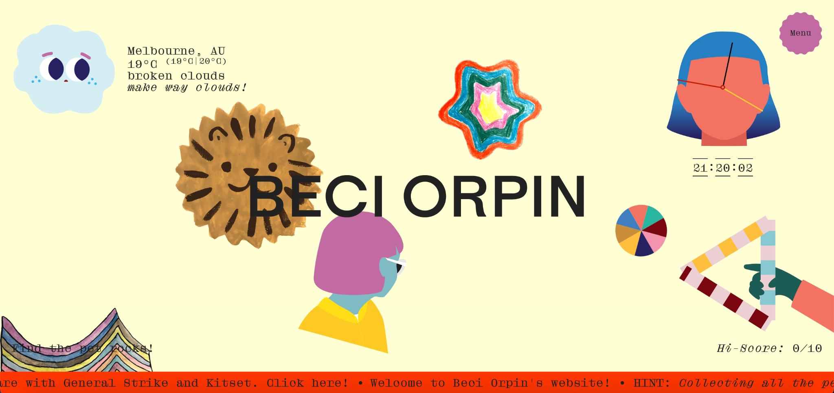
Inspiration
Pinterest Board
https://suzychan.com/
https://fettburger.com/graphic
https://www.beciorpin.com/
https://lilyclementineorset.hotglue.me/?projects
https://kellauren.design/

Slide 5
Learned Skills
HTML syntax: semantic tags
HTML forms
Embed images and links
Navigation bar and links
Using alt text
CSS Box Model: padding, borders, and margins
Some 2D transformations
Flexbox: container and items
Positioning Elements
Hovering effects
Skills to Learn
Making the nav bar stay
Custom cursors
Overlapping images
Social media buttons
Different shapes: circles, triangles
Different types of animation: images moving across screen in a line

Slide 6
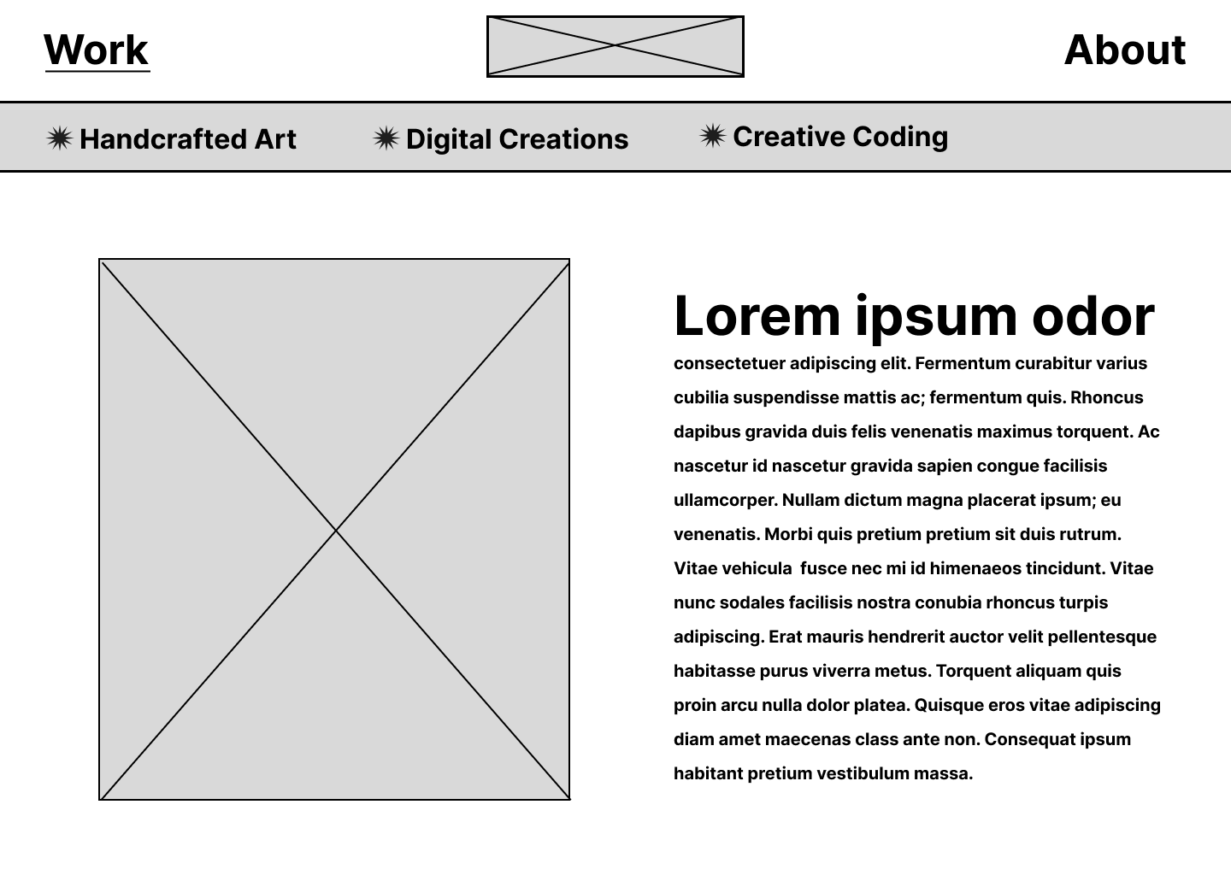
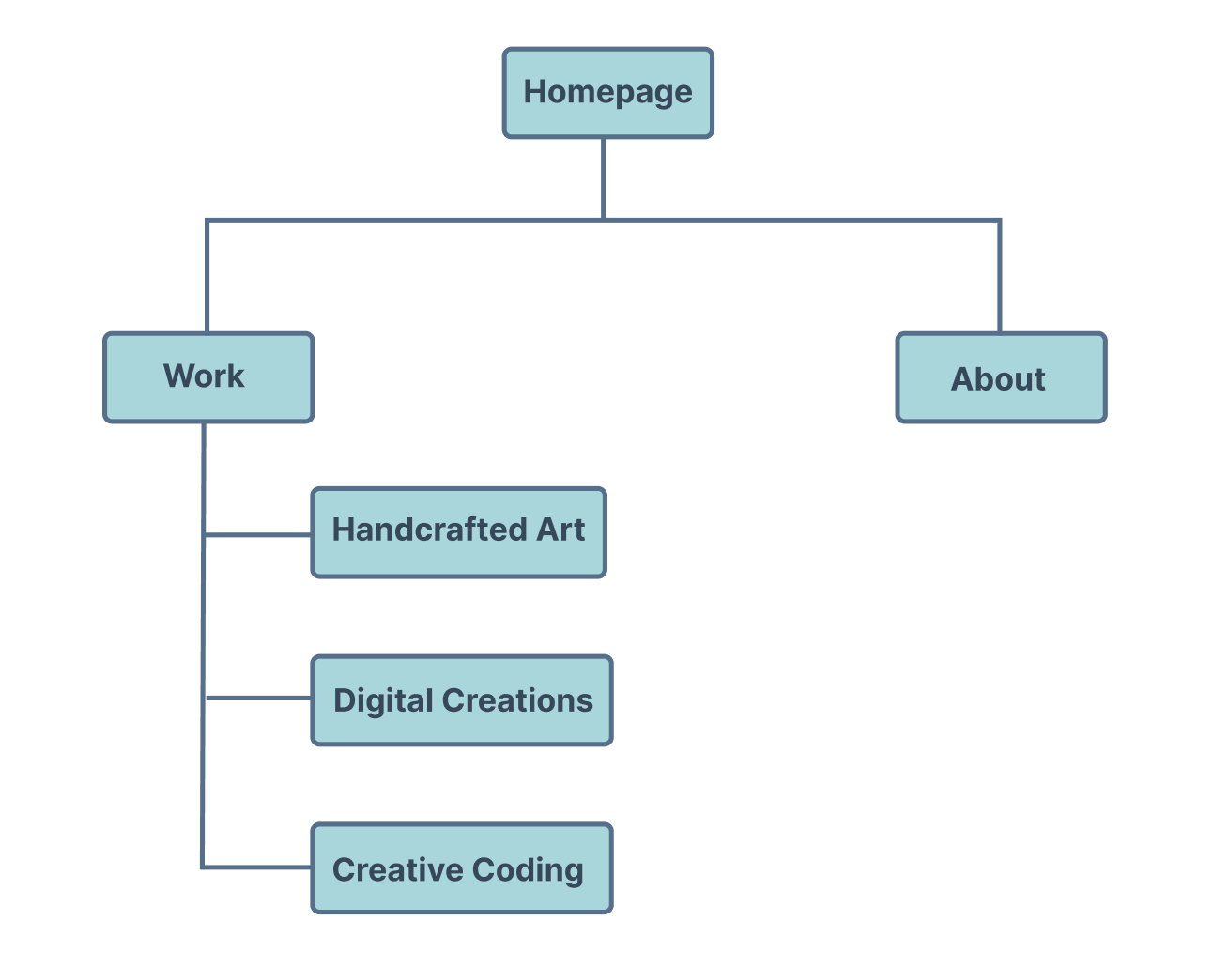
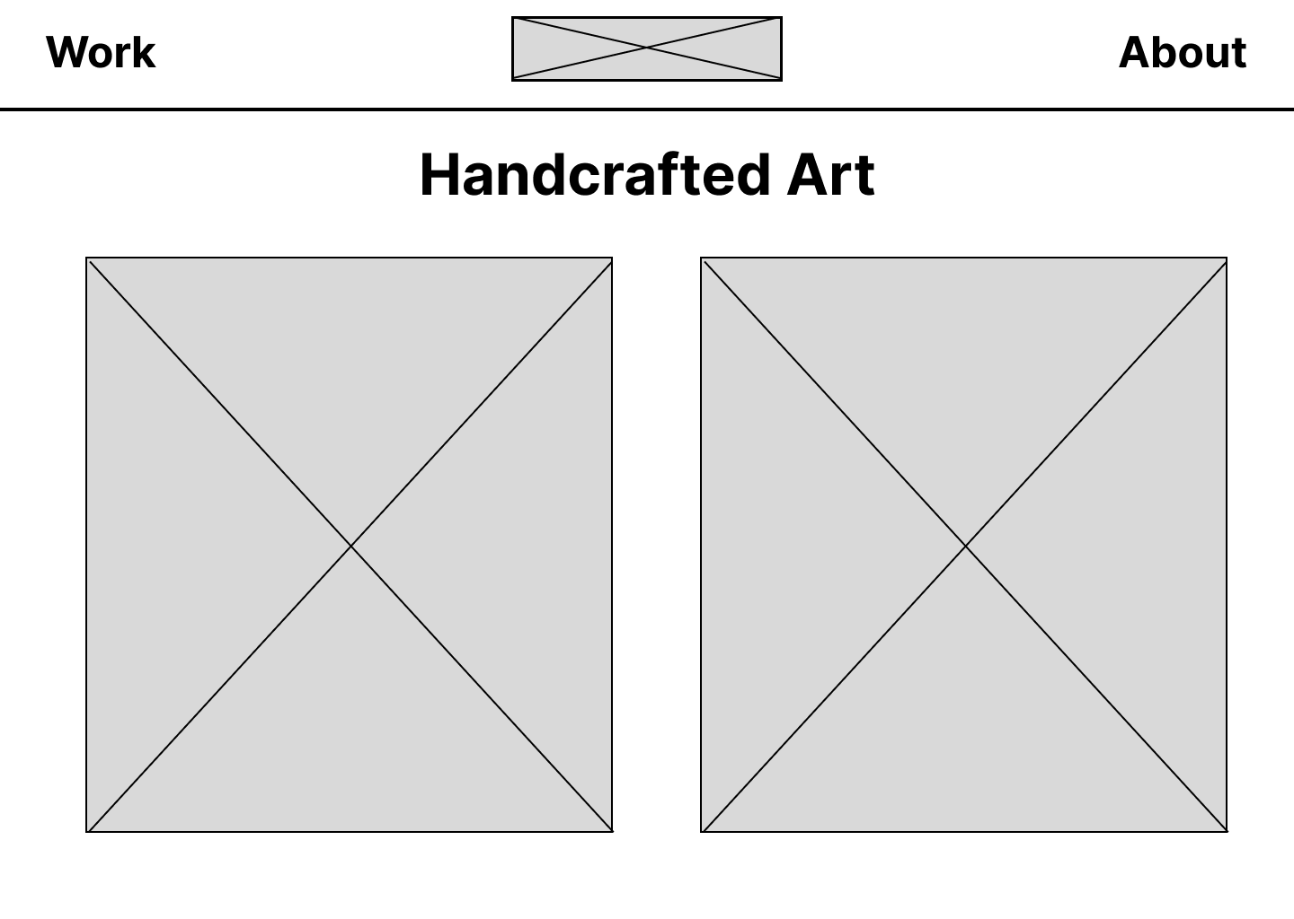
Site Map and Wireframes

Slide 7
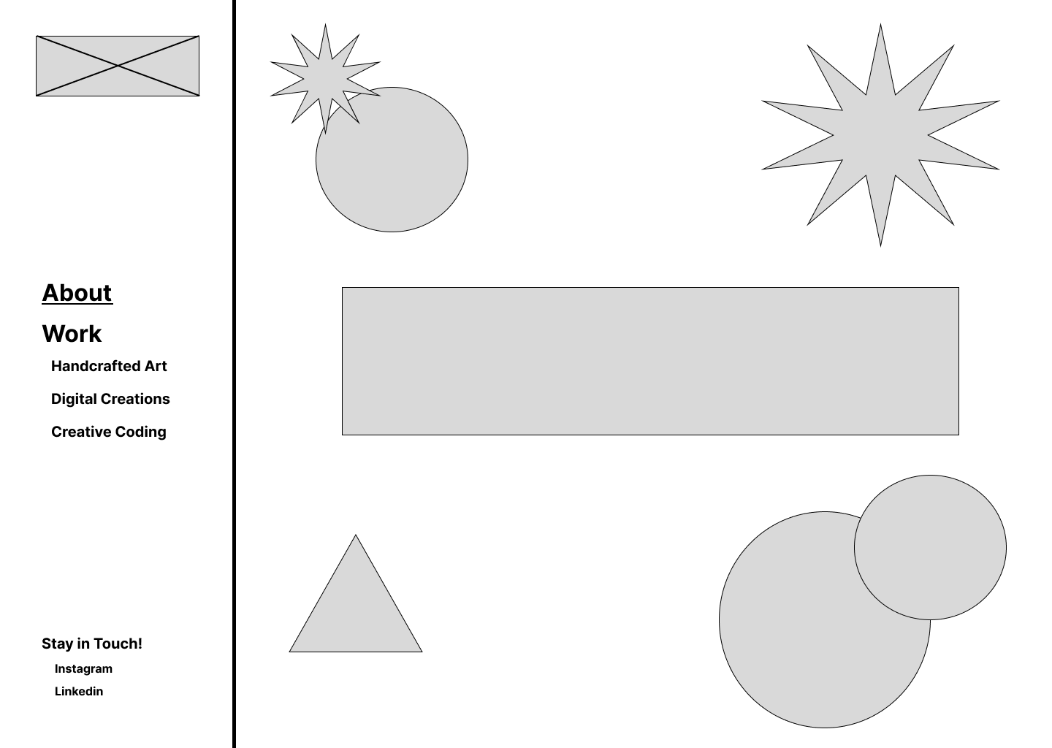
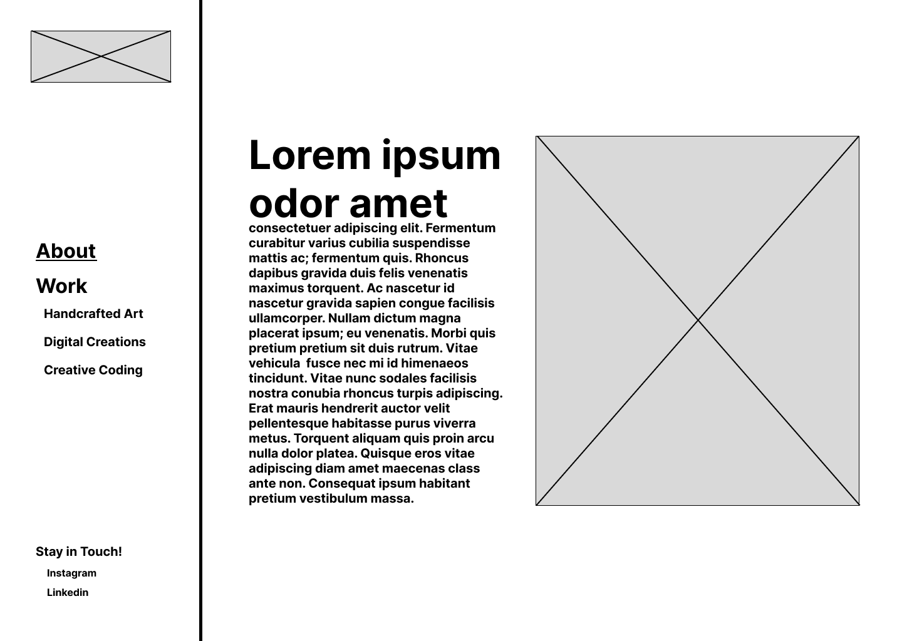
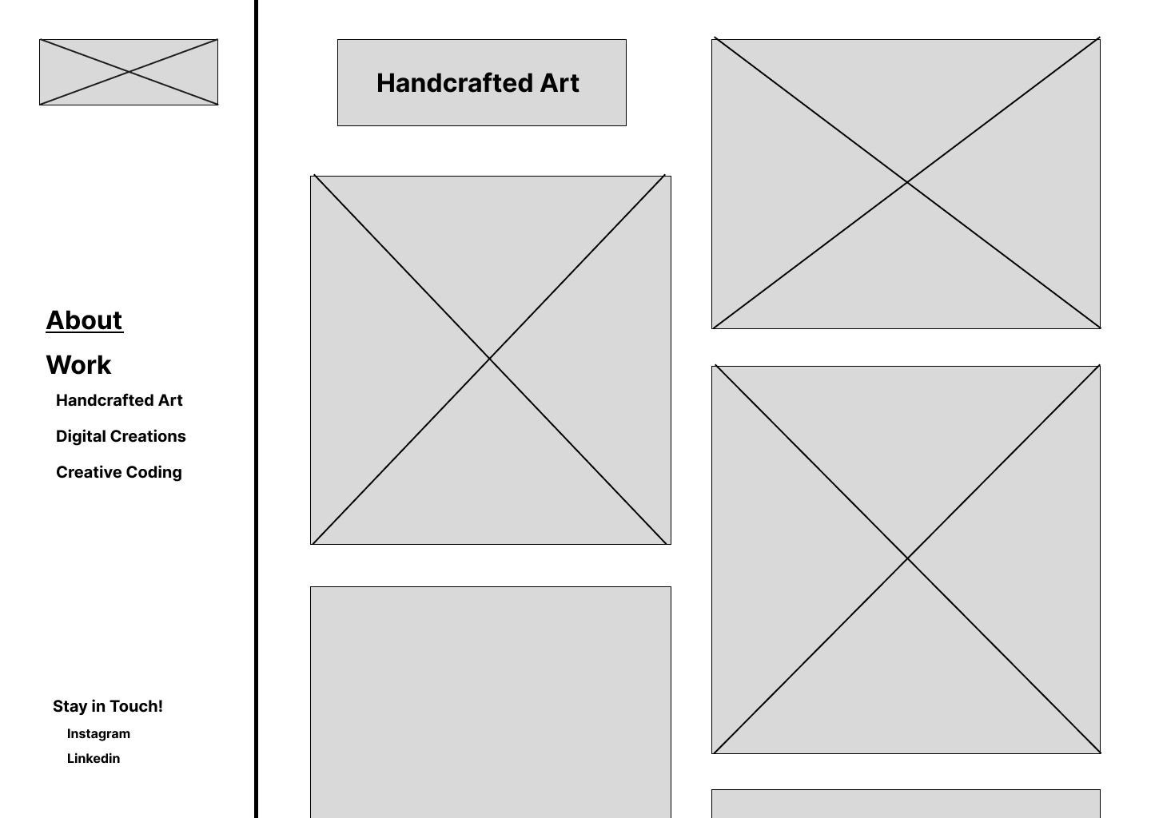

Slide 8
Thank you!

